Slide 1
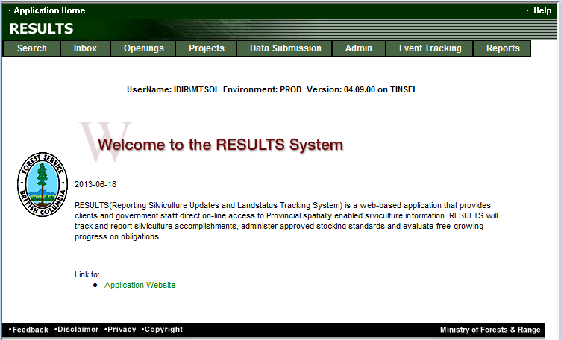
RESULTS Training
Carbon Offset Reporting to RESULTS
Sept 2013

Slide 2
Learning Objectives
Identify key documentation and reference materials
Overview of Online and ESF Components and mandatory requirements for Carbon Offset Projects
Demonstration of the creating and update an Opening

Slide 3
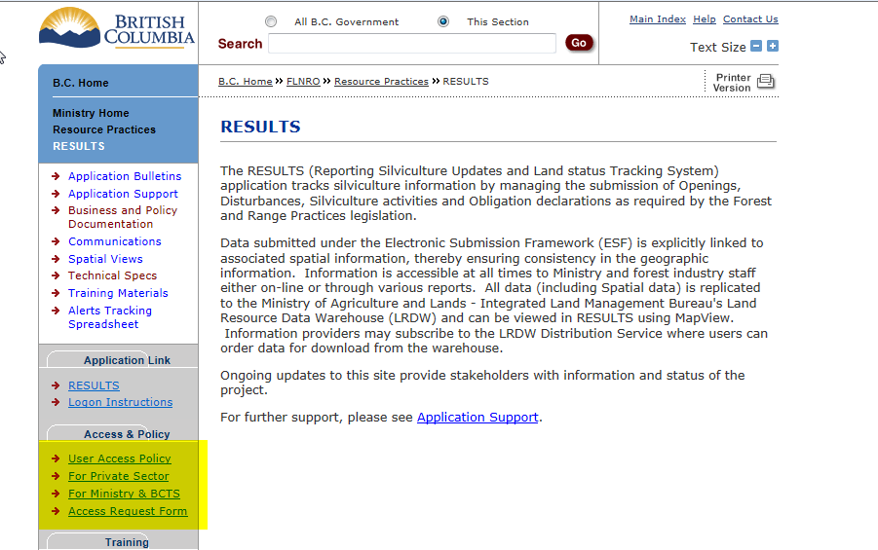
Getting Access to RESULTS
Must have bceid account and then apply via Access Request Form

Slide 4
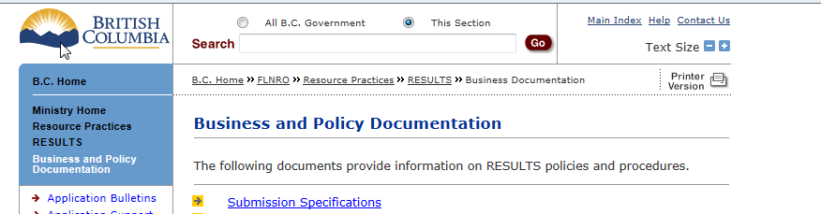
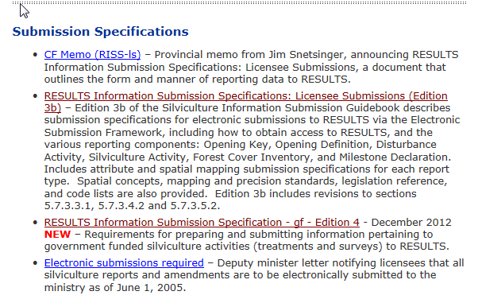
Business Guidance
http://www.for.gov.bc.ca/his/results/business.htm

Slide 5
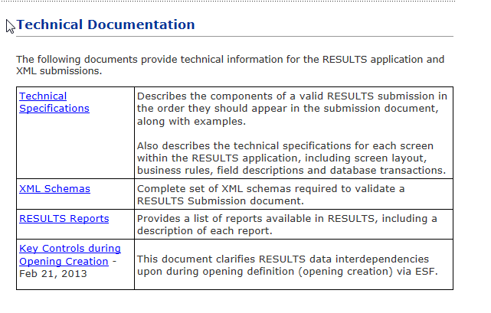
Technical Documentation References http://www.for.gov.bc.ca/his/results/techDocs.htm

Slide 6
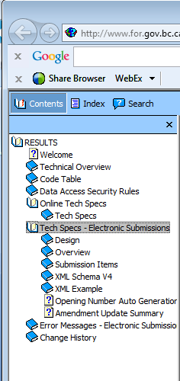
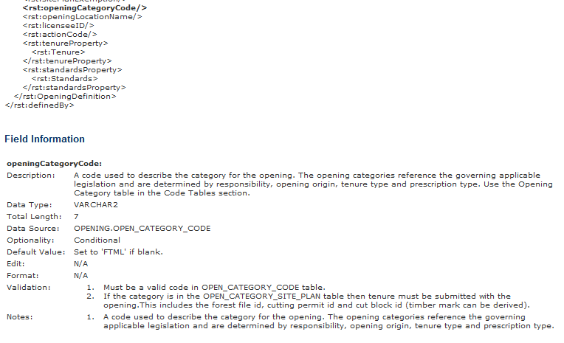
Technical Documentation ESF Schema References
http://www.for.gov.bc.ca/his/results/techDocs.htm
Tech Specs has ESF Reference with business rules and field specific edits.
Reference is by schema item.

Slide 7
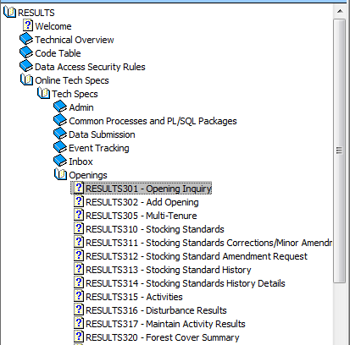
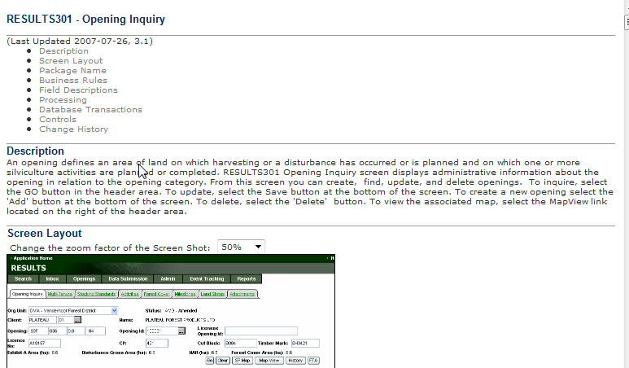
Technical Documentation Online References
http://www.for.gov.bc.ca/his/results/techDocs.htm
Tech Specs has Online Reference with business rules and field specific edits.
Reference by Screen Number.

Slide 8
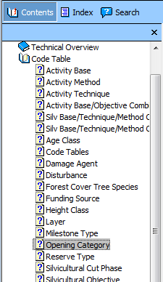
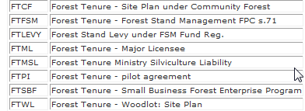
Technical Documentation Codelists
http://www.for.gov.bc.ca/his/results/techDocs.htm

Slide 9
Conceptual – Carbon Offset Reporting
Licence of Occupation
5
3
1
2
4
New Openings represented by Carbon Offset Contract
5
1
3
4
2
Carbon Offset Contractor ABC
Carbon Offset Contractor DEF
Opening 1
Opening 2
Opening 3
Opening 4
Opening 5

Slide 10
Reporting Steps
Online – Create new Opening in RESULTS
Submit ESF for Opening Spatial and Standards Unit(s) with MOF Default Standards
Submit Activities (Online or ESF)
Submit ESF Forest Cover

Slide 11
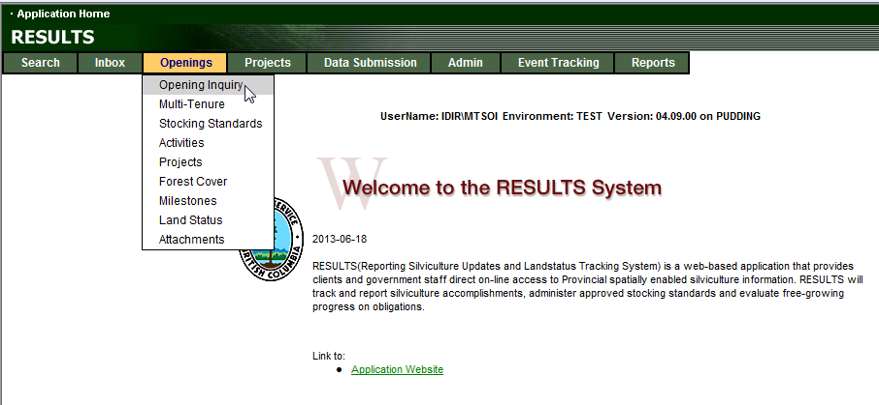
Online – Create new Opening in RESULTS

Slide 12
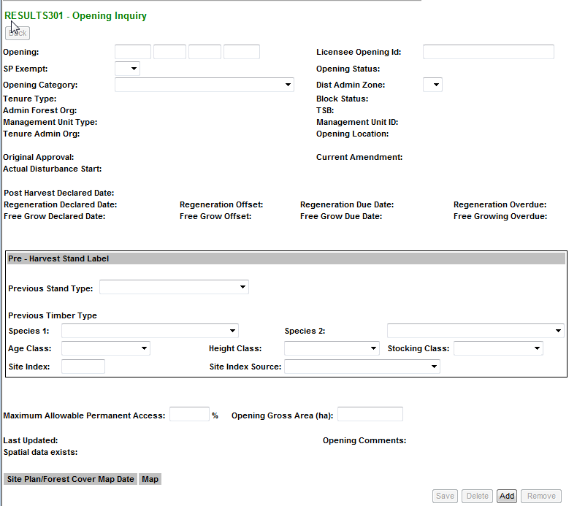
Online – Create new Opening in RESULTS
Go to Bottom of S301 Opening Inquiry
“Add” to Add new Opening

Slide 13
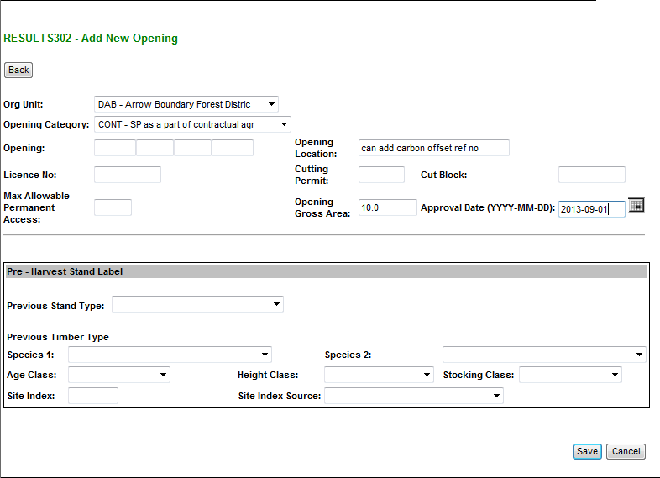
Online – Create new Opening in RESULTS
Mandatory Fields
Org Unit
Opening Category: CONT
Opening Gross Area: Treatment Area (ha)
Approval Date: Date of Treatment
Optional Field
Opening Location may assist in tracking of the Carbon Offset Contract
System will default Max Allowable Permanent Access to 7%

Slide 14
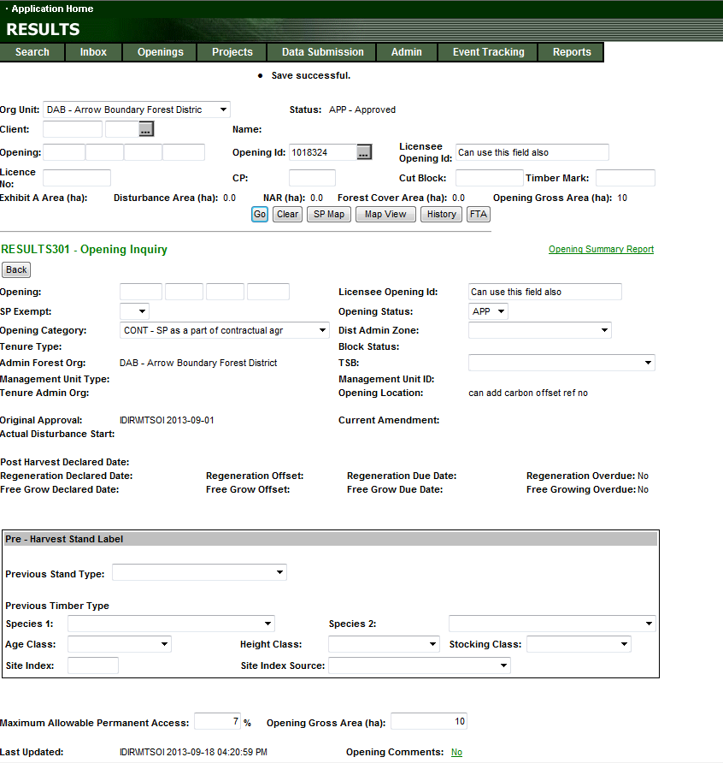

Online – Create new Opening in RESULTS
Tombstone Fields in this upper portion of the screen is not updatable.
Used to identify Opening for reference
New Opening ID assigned
Optional Fields:
Licensee Opening ID may be useful for tracking
Opening Location is entered at Opening creation but cannot be updateable online once created.
Lower portion of screen is updatable. Fields available for update are in boxes.
Opening will default to “APP” Approve Status
System will default Max Allowable Permanent Access to 7%
If modify data – Need to “Save”

Slide 15
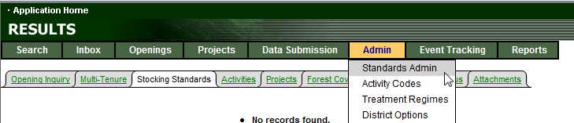
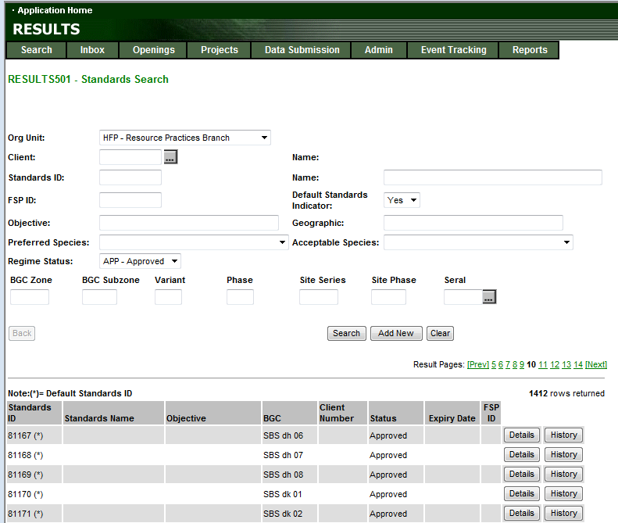
2. Submit ESF for Opening Spatial and Standards Unit(s) with
MOF Default Standards
MOF Defaults can be searched via S501
Specify:
HFP for Ministry Defaults
Default Standards Ind: Yes (MOF Default)
Regime Status: Approved
May search by BEC to narrow options

Slide 16
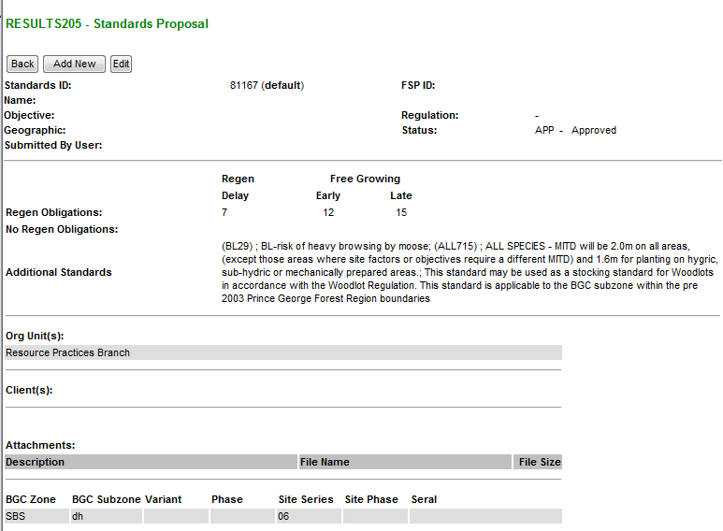
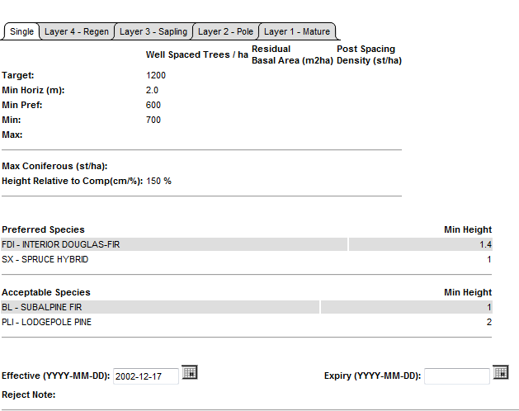
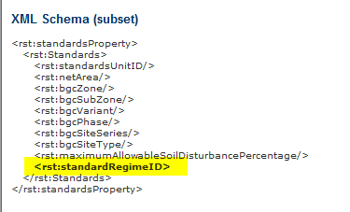
2. Submit ESF for Opening Spatial and Standards Unit(s) with
MOF Default Standards
Resource Practices Branch have default standards that are based on FDP Stocking Standards.
These are recommended for use for Carbon Offset Projects.
Standards ID numbers are used for Standards Unit ‘s Stocking Standards for ESF submission as <rst:standardRegimeID>
Resource Practices Branch’s Default Standards may be used by any Org Unit and any Clients for Carbon Offset Projects.

Slide 17
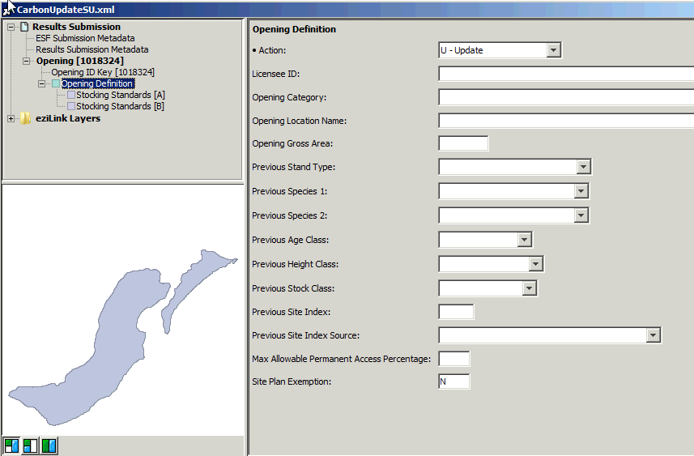
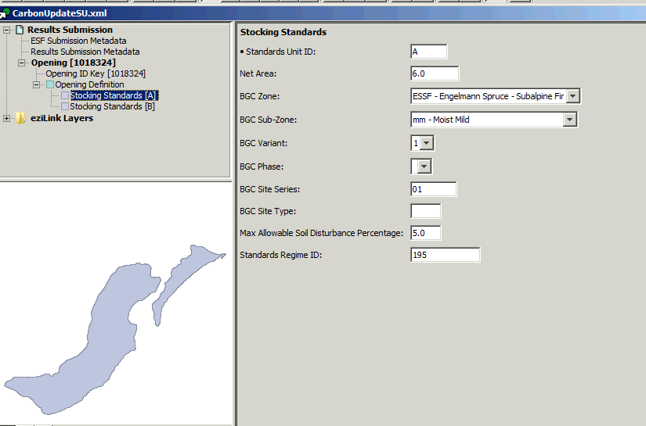
2. Submit ESF for Opening Spatial and Standards Unit(s) with
MOF Default Standards
Software example uses EzLink¹ for illustration purpose of
ESF set-up
Opening ID created from online process is used for submission
“U”- Update will be used for include new SUs to existing Opening
No data is required for opening definition unless you want to update .
Site Plan Exemption is set to “N”
Opening Spatial represented all carbon treated areas included in Opening Definition
Standards Unit(s) is included with mandatory Data:
  Standards Unit ID
  Net Area
  BEC
  Maximum Soil Disturbance
  Valid Standards Regime ID (use Ministry FDP Default Stocking Standard)
  SU boundary(s)
¹ Ezlink is a propriety software. There are other software that maybe used to create ESF submission.

Slide 18
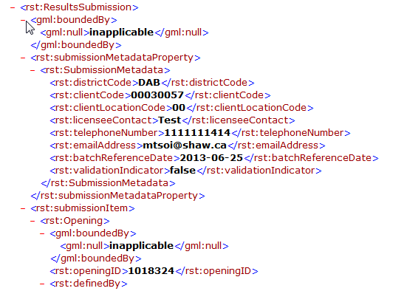
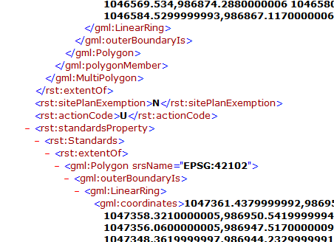
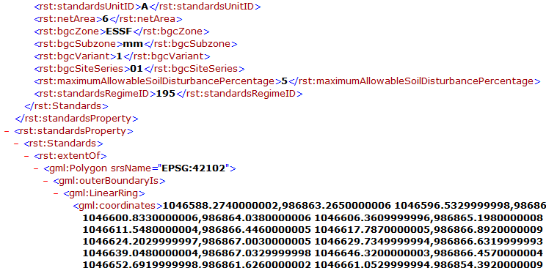
2. Submit ESF for Opening Spatial and Standards Unit(s) with
MOF Default Standards
XML must contain:
Meta-data of submitter who is authorized to submit to RESULTS
Key – use Opening ID as the key
Action Code of “U” to update the standards unit component
Site Plan Exempt Indicator as “N”
Opening Spatial – comprise of all treatment reported for the carbon offset project
Standards Unit(s) – comprised of the treatment area as the Net Area, BEC, Max. Allowable Soil Disturbance, and Standards Regime ID approved for use (use Ministry FDP Stocking Standard Defaults), and Standards Unit(s) spatial.

Slide 19
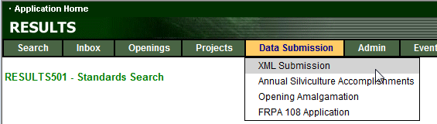
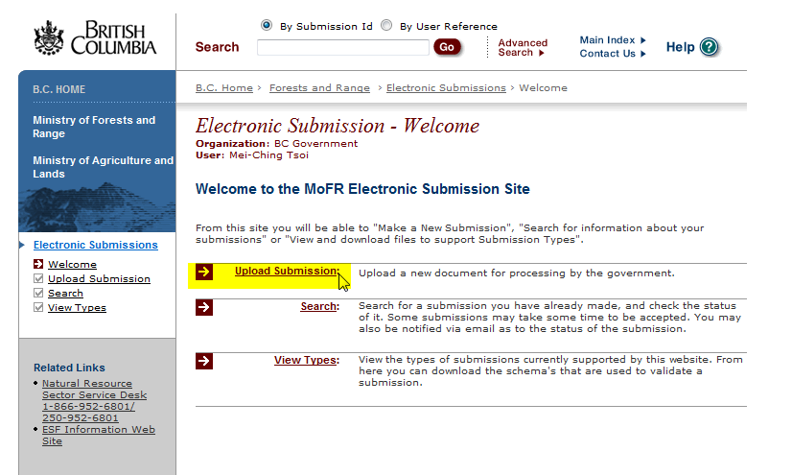
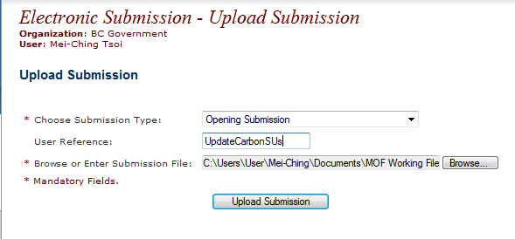
Submission Process
Must specify Submission Type: Opening Submission

Slide 20
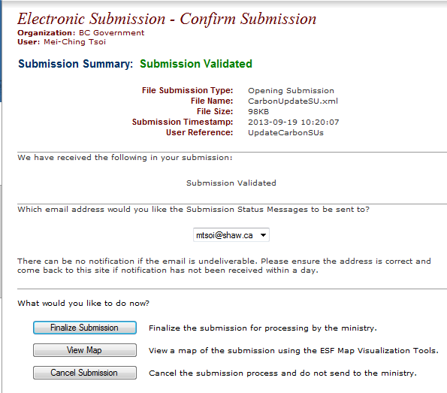
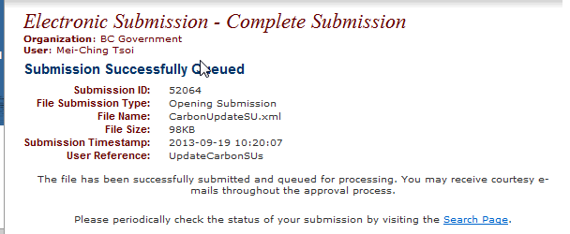
Submission Process

Slide 21
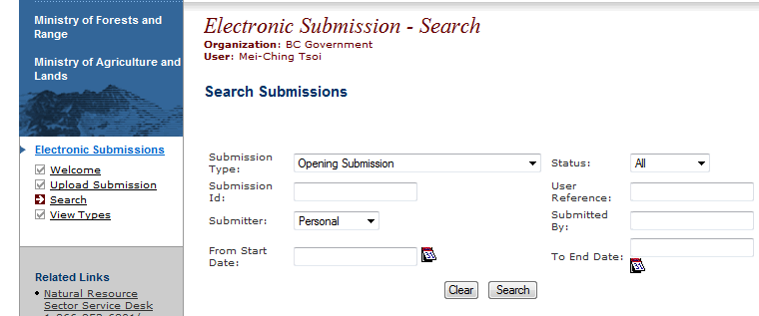
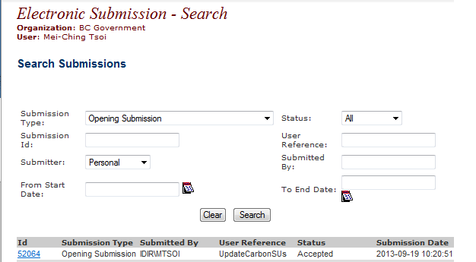
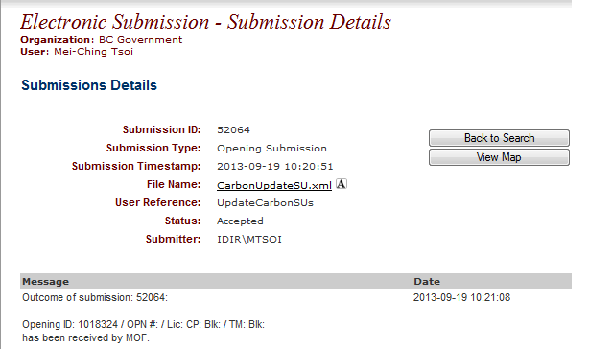
Submission Process
Must specify Submission Type: Opening Submission
Confirmation of Pending, Acceptance, or Rejection
Ability to reference XML submitted and any submission errors if rejected.

Slide 22
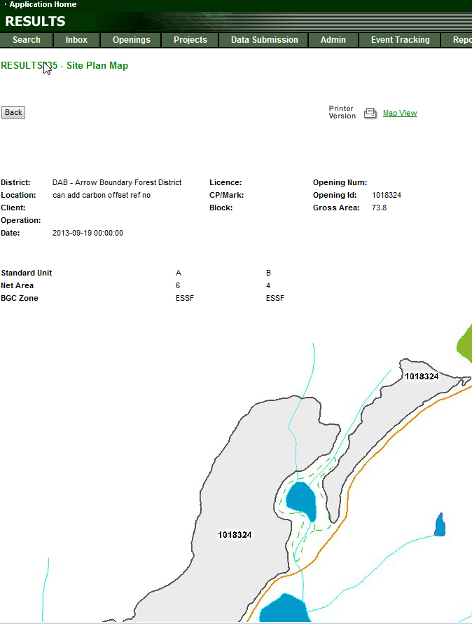
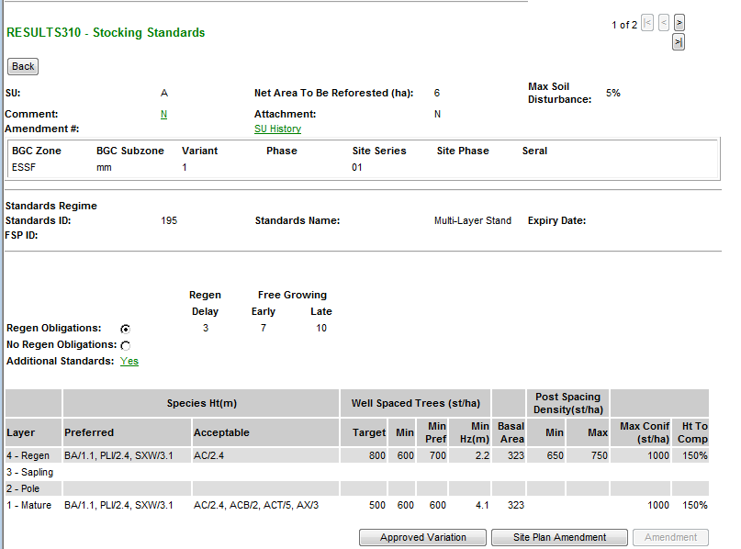
2. Submit ESF for Opening Spatial and Standards Unit(s) with
MOF Default Standards
XML must contain:
One or more SUs created with BEC, NAR, Max Soil Disturbance %
Standards Regime ID will default all data elements the SU (RG/FG Offsets, Stocking Standards)
SP Map and Opening Spatial

Slide 23
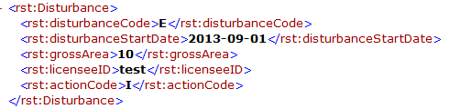
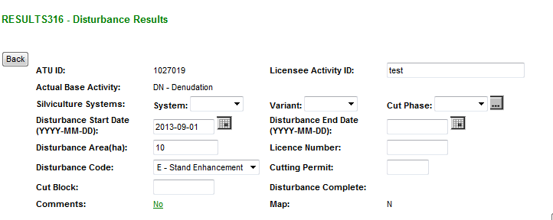
3. Submit Activities (Online or ESF)
Use “I”-Insert for newly completed activities
Disturbance Activity must exists (pre-condition for Forest Covers Submission
Mandatory:
Action Code: “I”-Insert
Disturbance Code: “E”- Stand Enhancement Disturbance Code
Disturbance Start Date (start of treatment date)
Treatment Area as the Gross Area

Slide 24
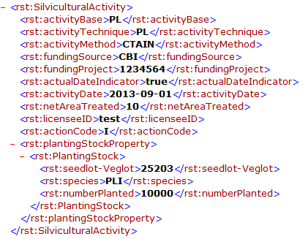
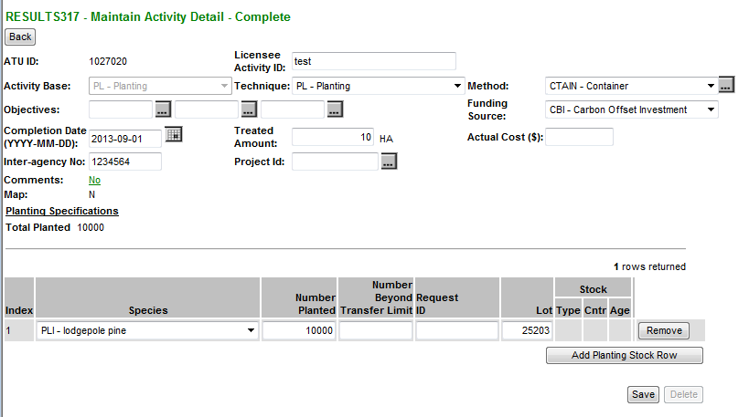
3. Submit Activities (Online or ESF)
Use “I”-Insert for newly completed activities
Use Funding Source “CBI”
Optional: Licensee ID or fundingProject fields can assist in providing added information for tracking (Carbon Offset Agreement number)
Mandatory:
Base/tech/method
Funding Source Code
Completion Date
Treated amount
If Planting, Seedlot/Veglot, Species and Number trees planted
E-Stand Enhancement

Slide 25
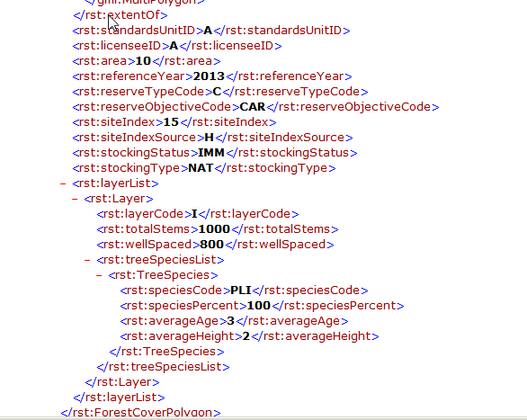
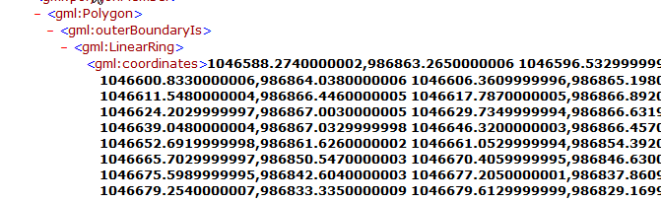
4. Submit Forest Cover(ESF Only)
Use “I”-Insert represented the forest cover for the treated areas
Use Reserve Type Code: “C”-Carbon Reserve Objective Code: “CAR”-Carbon
Mandatory:
Polygon ID, Forest Cover Area, Stocking Status, Stocking Type, Site Index, Site Index Source Code, Reference Year
Inventory and Silviculture Components with Density , Species, Species %, Avg Ht and Avg Age
FC Spatial representing the treated area
E-Stand Enhancement

Slide 26
Demonstration
E-Stand Enhancement

Slide 27
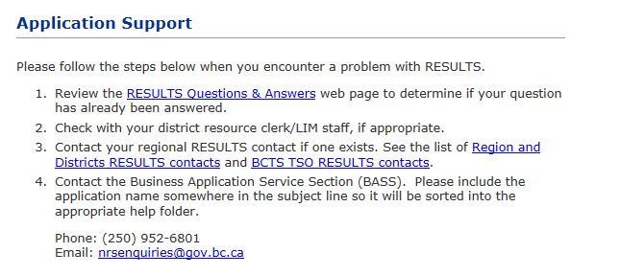
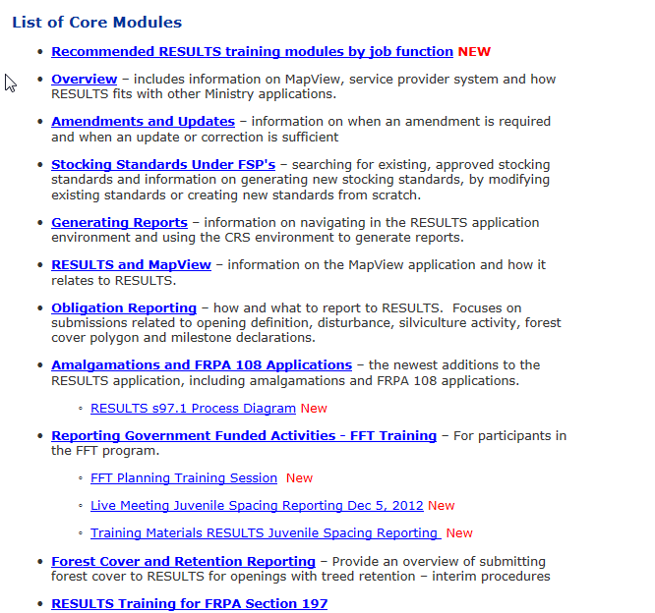
Help Resources
http://www.for.gov.bc.ca/his/results/support.htm
http://www.for.gov.bc.ca/his/results/training/index.htm
E-Stand Enhancement

